Slide 1
Overview Weed Count ACRES – Summer 2022

Slide 2
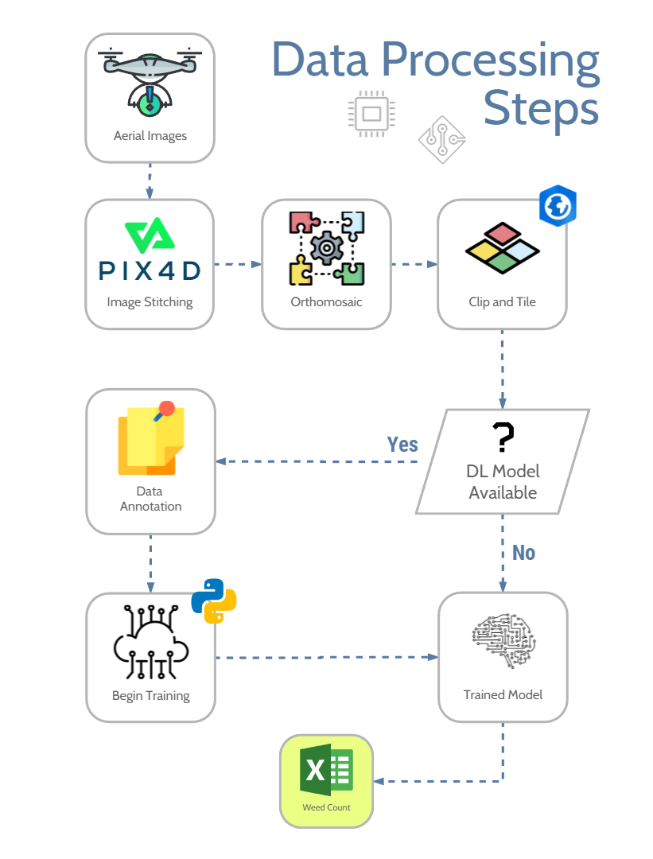

Slide 3
CORN – DAY0 - Overall

Slide 4
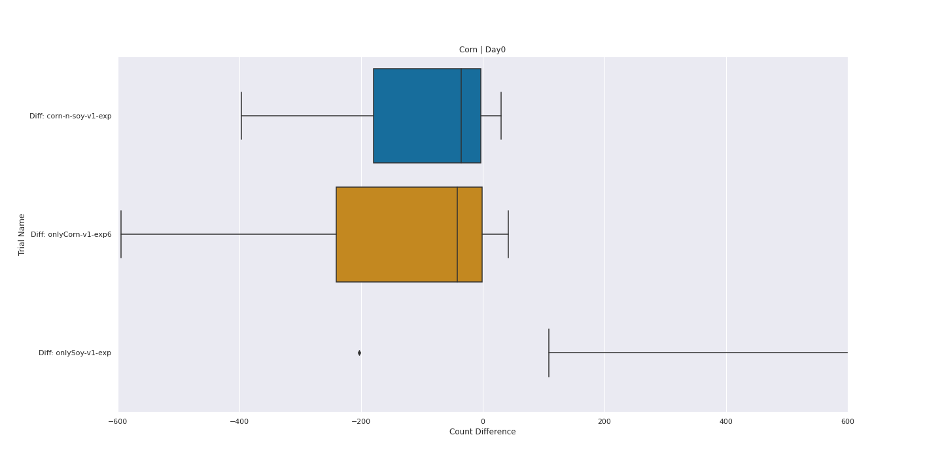

Slide 5
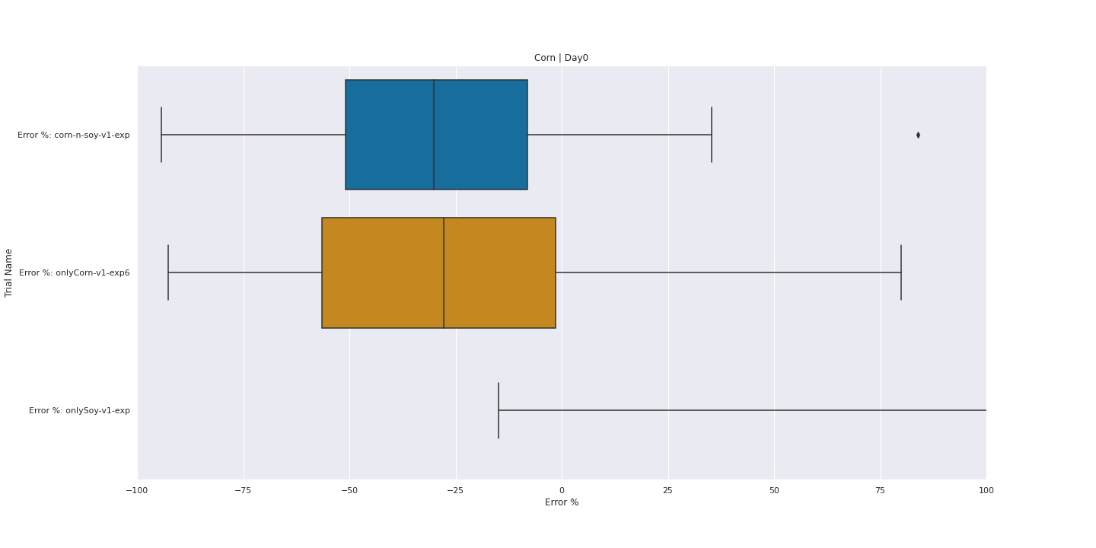

Slide 6
CORN – DAY5 - Overall

Slide 7
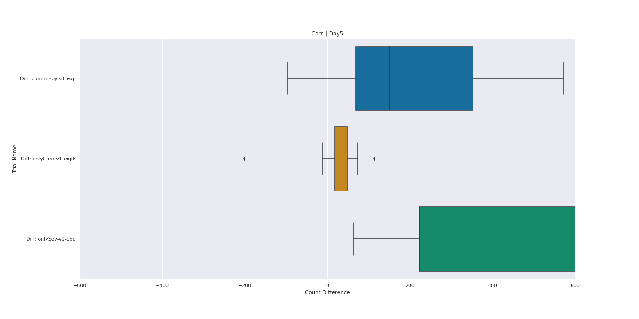

Slide 8
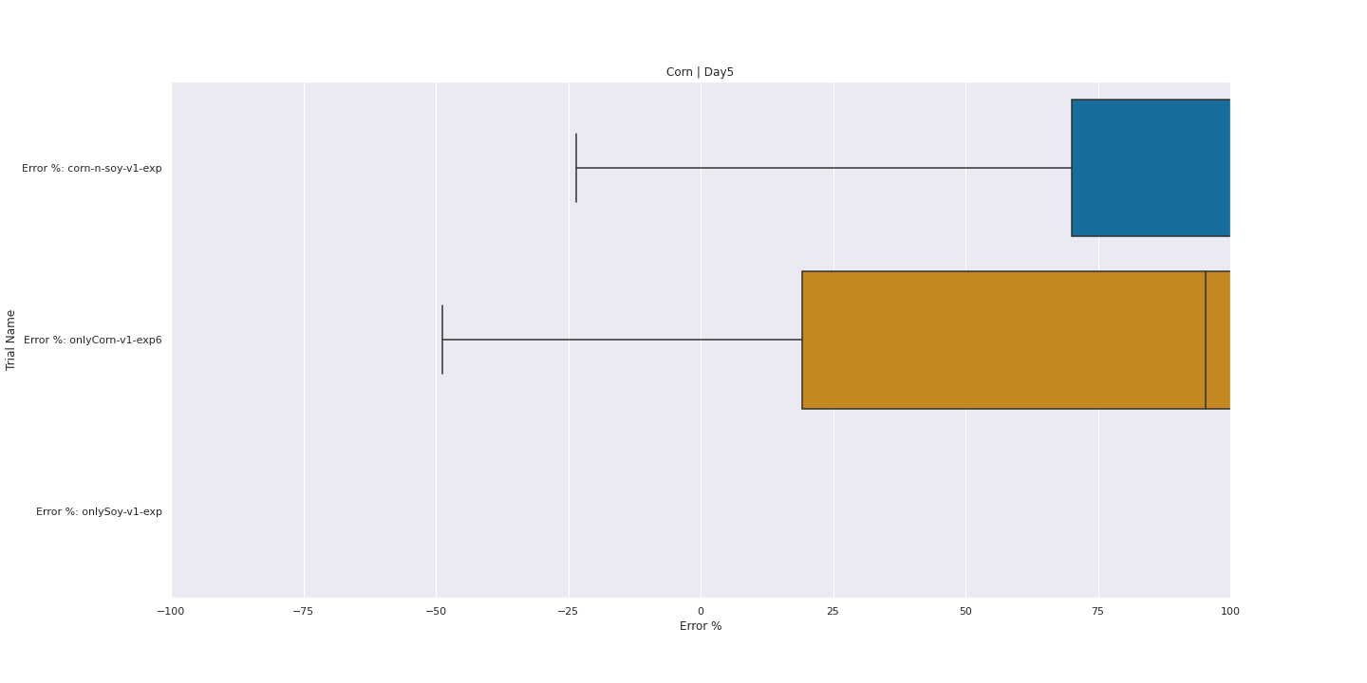

Slide 9
SOY – DAY0 - Overall

Slide 10
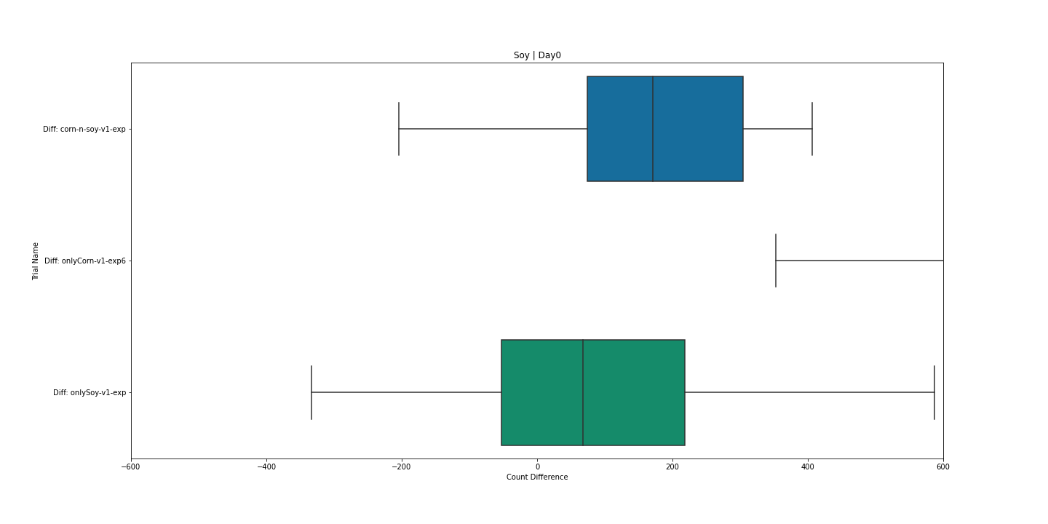

Slide 11
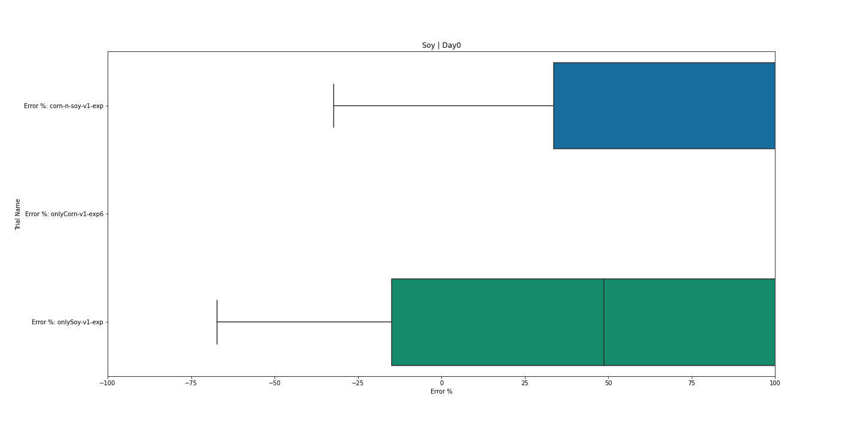

Slide 12
CORN – DAY0 - SIZE

Slide 13
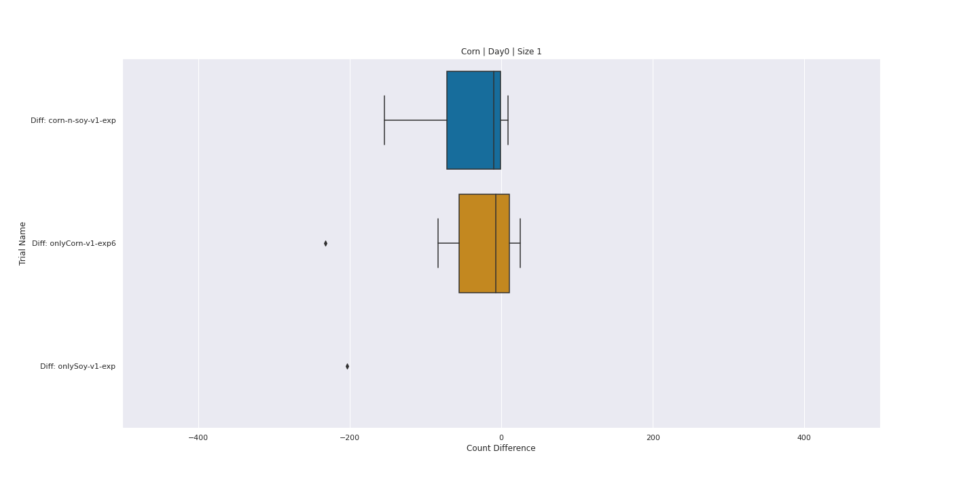

Slide 14
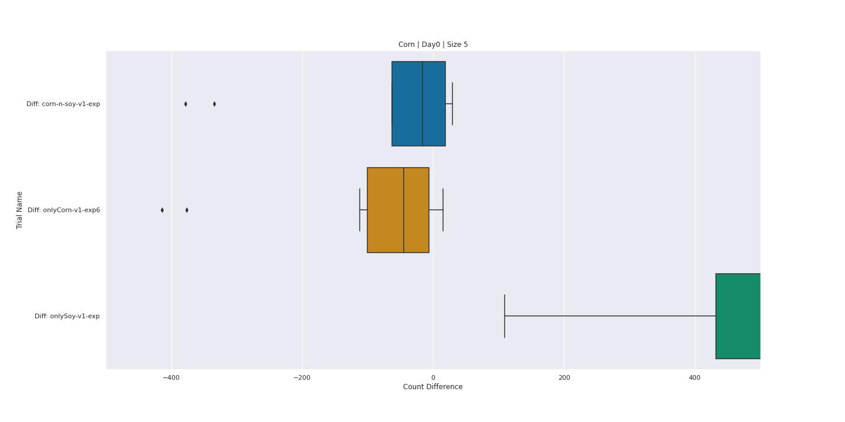

Slide 15
SOY – DAY0 - SIZE

Slide 16
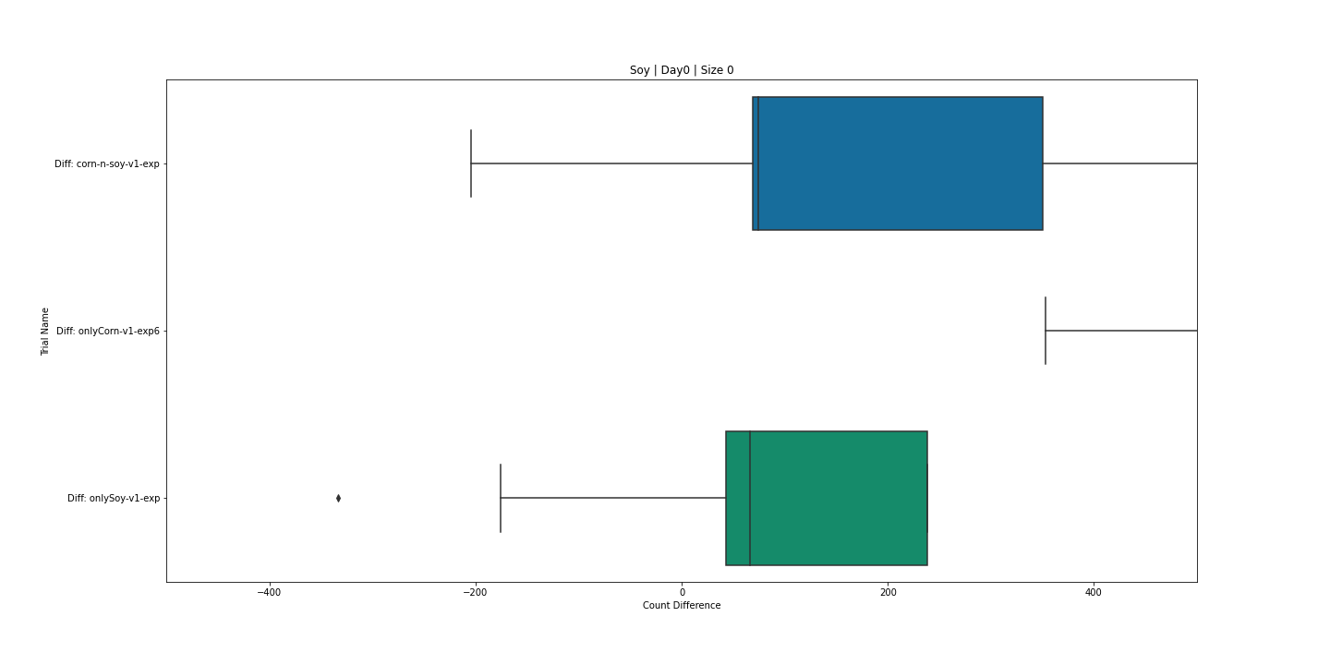

Slide 17
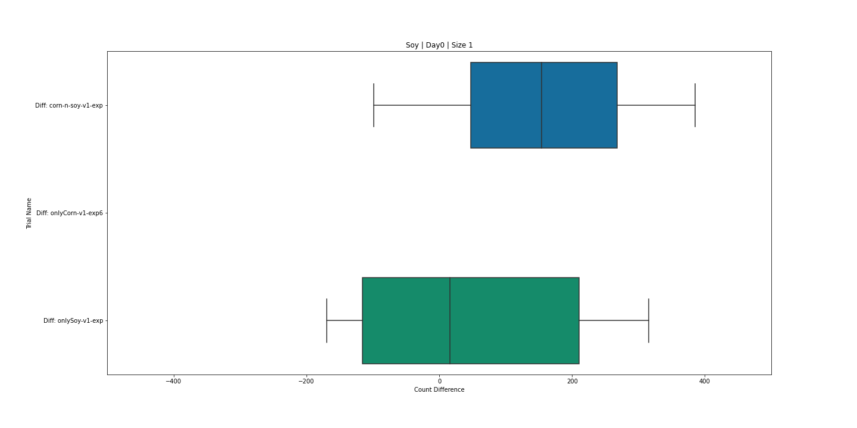

Slide 18
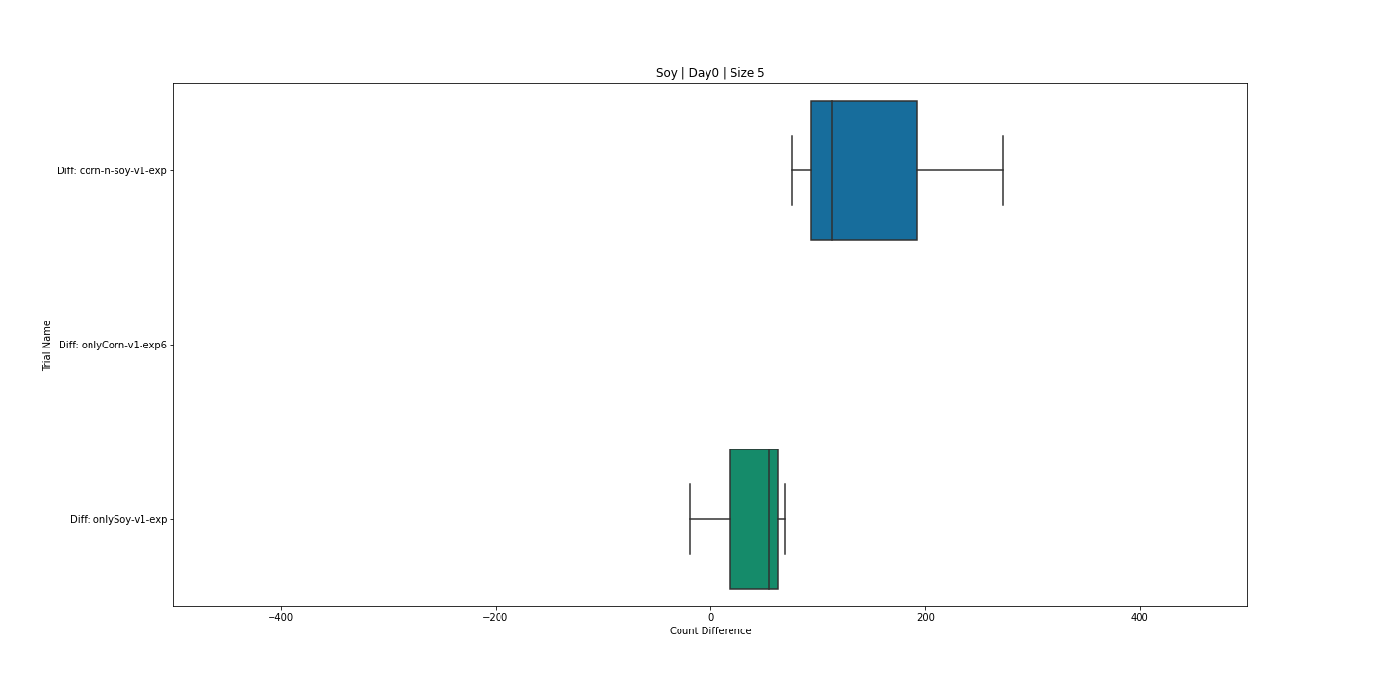

Slide 19
CORN – DAY0 – GROWTH STAGE

Slide 20
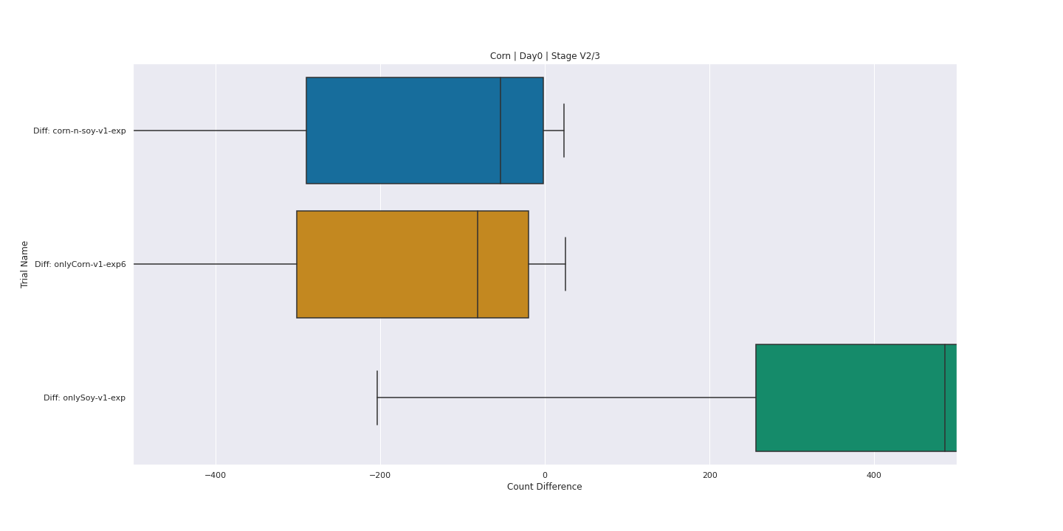

Slide 21
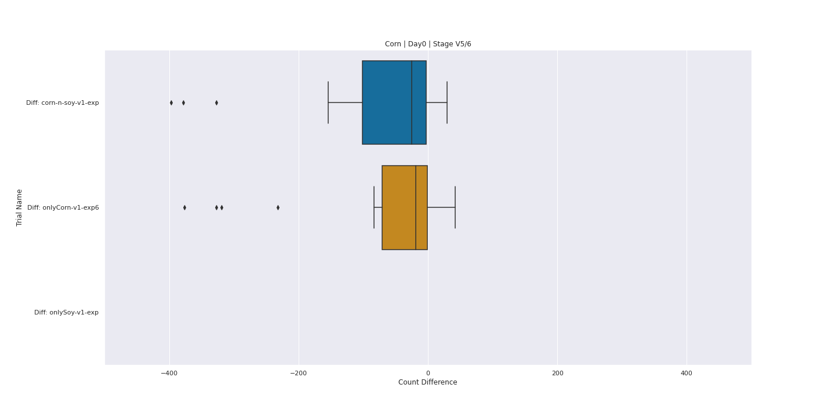

Slide 22
SOY – DAY0 – GROWTH STAGE

Slide 23
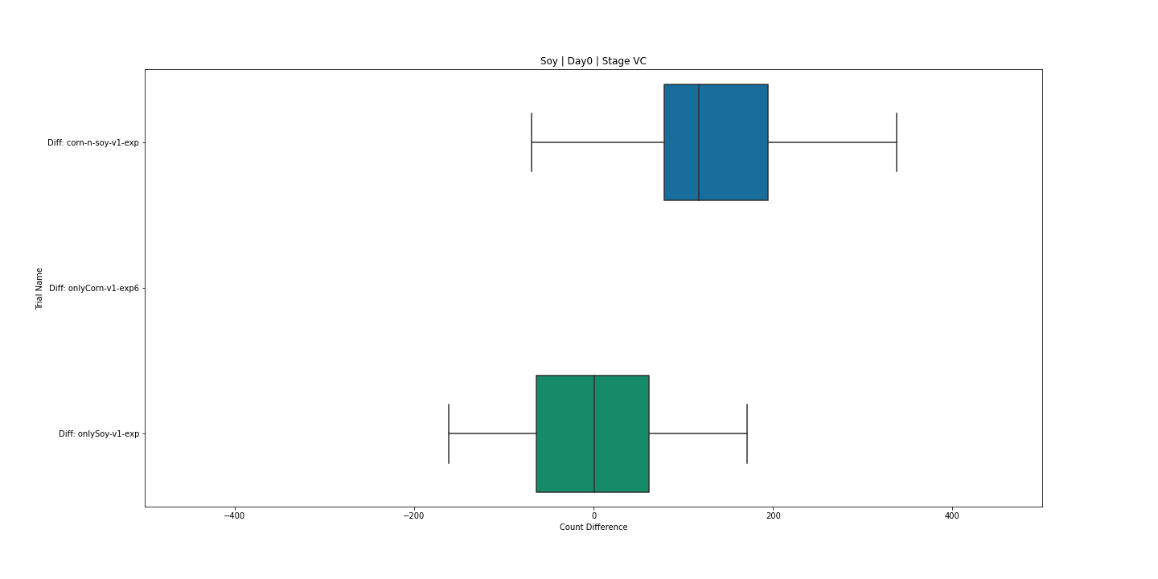

Slide 24
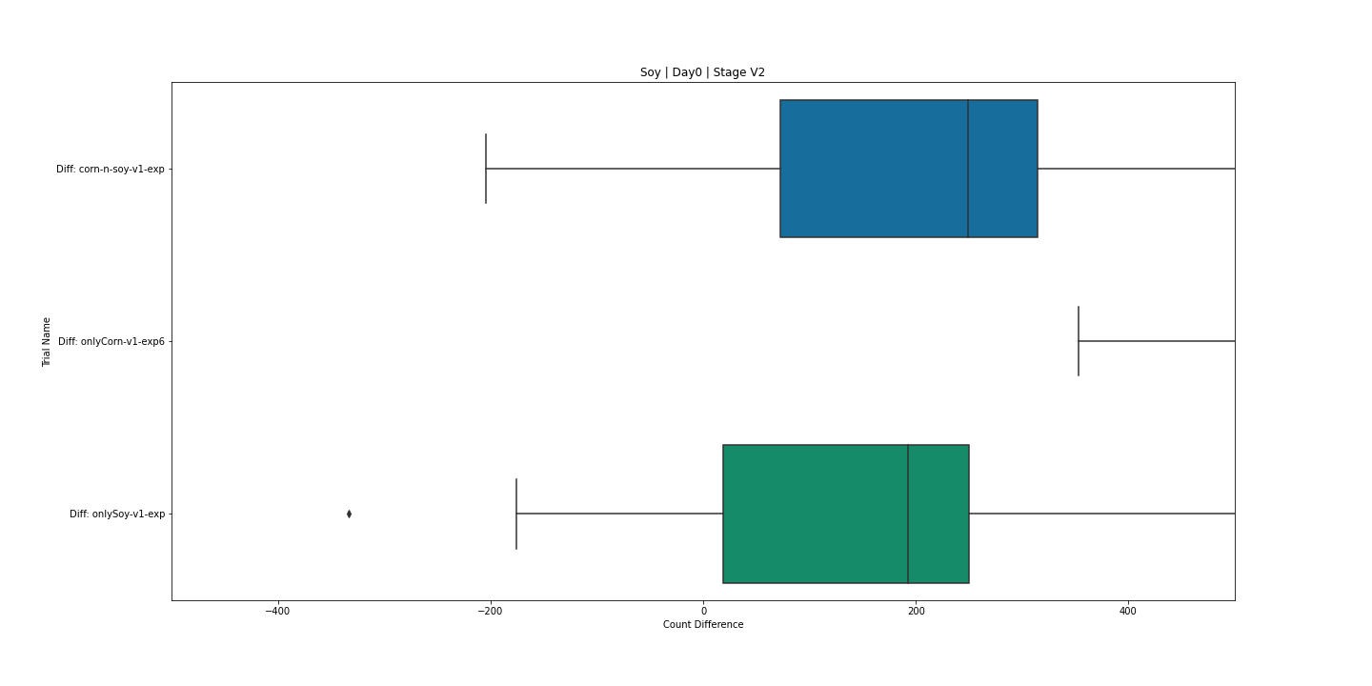

Slide 25
TRAINING DATA STATS CORN

Slide 26
Plot Number | Treatment | Corn Stage | Size | Manual Count | Number of Training Images | Number of Weeds
101 | 1 | V2/3 | 1 | 176 | 87 | 118
102 | 6 | V5/6 | 5 | 95 | 43 | 54
103 | 3 | V2/3 |  | 627 | 72 | 96
104 | 4 | V2/3 |  | 444 | 9 | 15
105 | 2 | V2/3 | 1 | 1359 | 202 | 1911
106 | 1 | V2/3 | 5 | 838 | 5 | 5
107 | 4 | V2/3 |  | 642 | 2 | 2
204 | 8 | V5/6 |  | 383 | 4 | 4
205 | 7 | V5/6 |  | 431 | 1 | 1
206 | 12 | V5/6 |  | 341 | 13 | 15
208 | 4 | V2/3 |  | 52 | 2 | 2
209 | 5 | V5/6 | 1 | 88 | 14 | 17
210 | 2 | V2/3 | 5 | 419 | 2 | 2
211 | 3 | V2/3 |  | 314 | 3 | 4

Slide 27
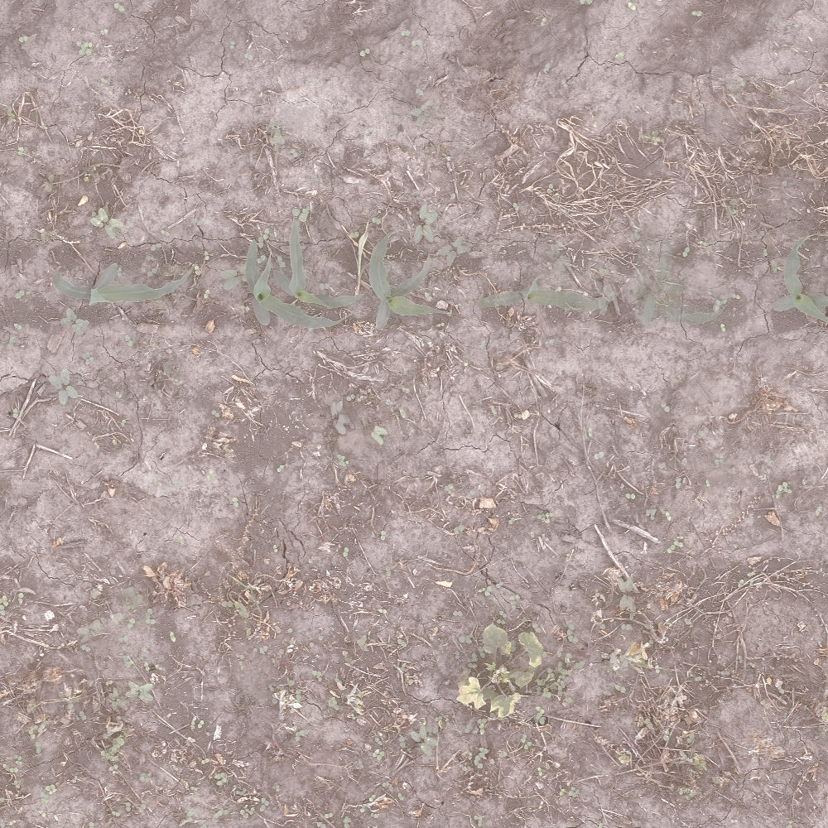
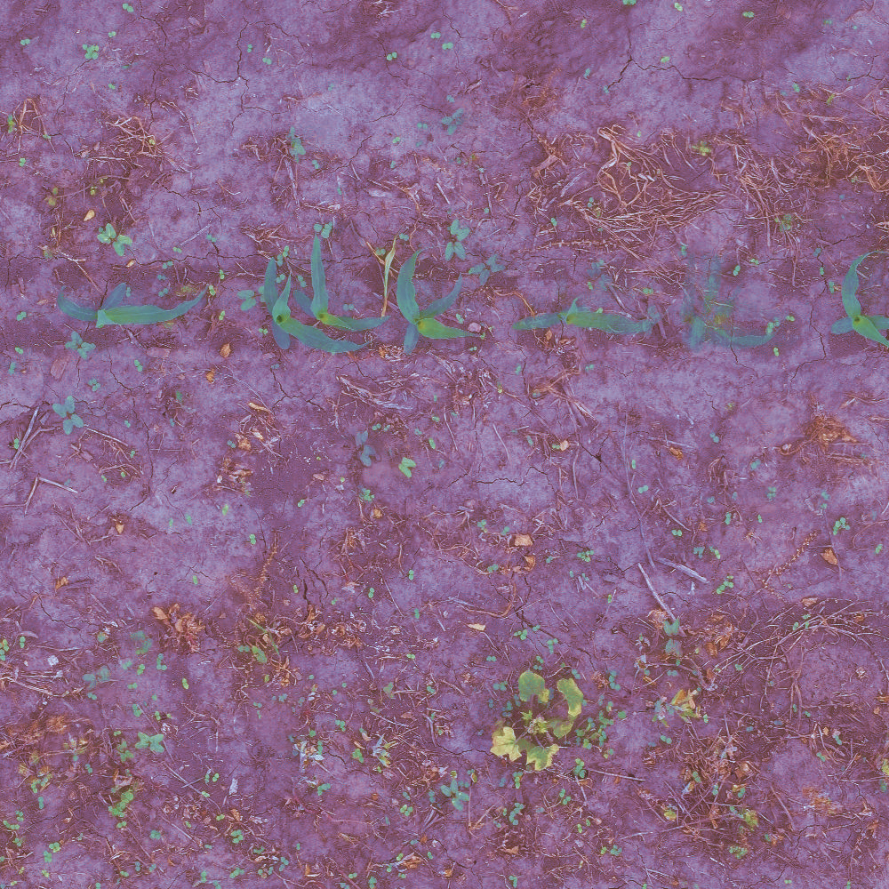
Original
Enhanced

Slide 28
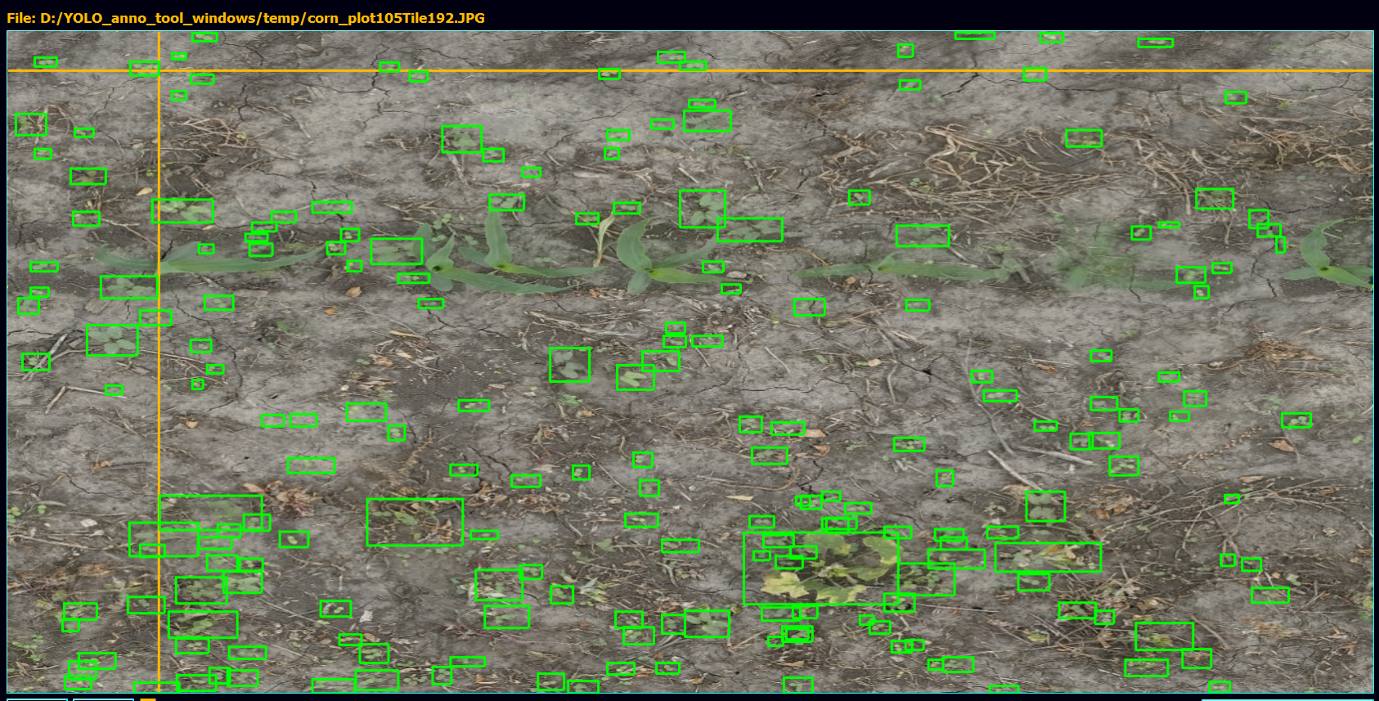
204 Weed instances

Slide 29
TRAINING DATA STATS SOY

Slide 30
Plot Number | Treatment | Soy Stage | Size | Manual Count | Number of Training Images | Number of Weeds
301 | 10 | V2 | 0 | 894 | 530 | 1689
308 | 8 | V2 |  | 187 | 66 | 87

Slide 31
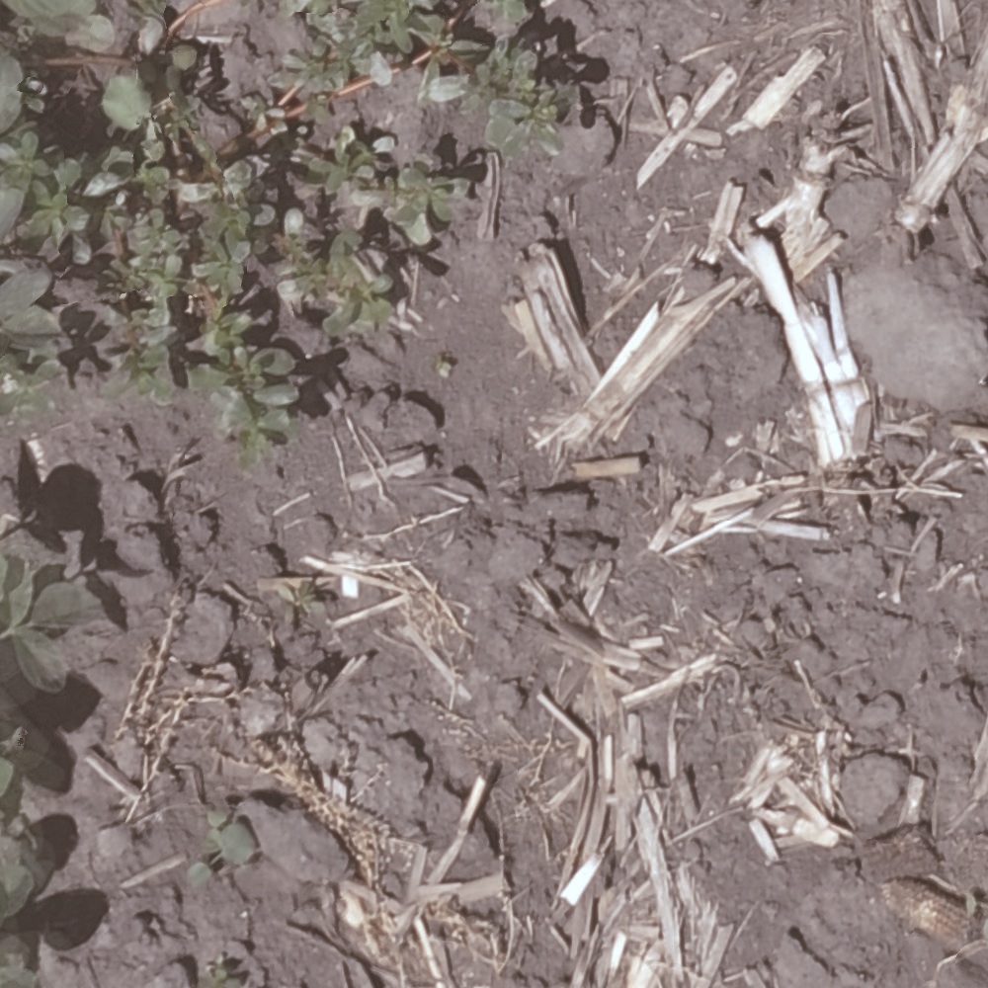
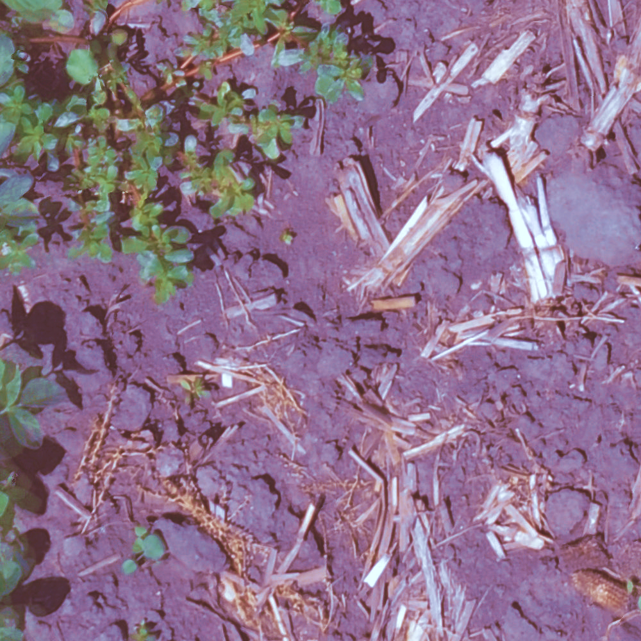
Original
Enhanced

Slide 32
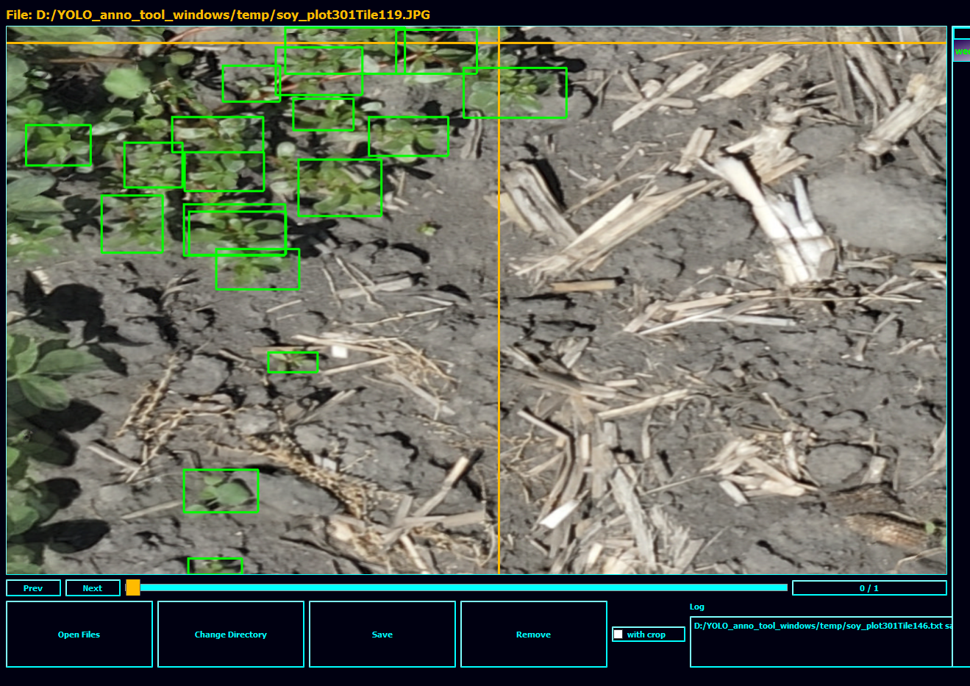
19 Weed instances

